Slide 1

Extraction of signal over background from spectral data using a Markov Chain Monte Carlo with a Gibbs sampler
Advanced Statistics for Physics Analysis
Prof. Alberto Garfagnini
Academic year
2019/2020

Slide 2

Content
Peak by peak analysis using JAGS
Finding the best estimates of parameters A, B, w, x0 and 95% credible interval.
Correlation among parameters both Qualitative (2D posterior distributions) and Quantitative (correlation matrix)
Inference → Histograms plot(visual understanding)
Check for convergence by re-running with different initial parameters
ACF: Effect of thinning and burn-in
Calibration: Using best estimates of peak center and energy emission (given)
Estimating number of events under each peak.
Esta foto de Autor desconocido está bajo licencia CC BY-NC-ND

Slide 3
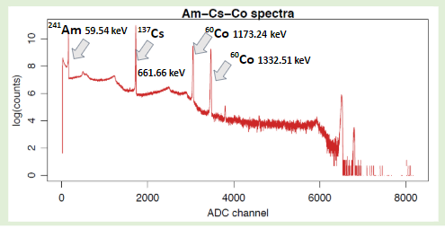
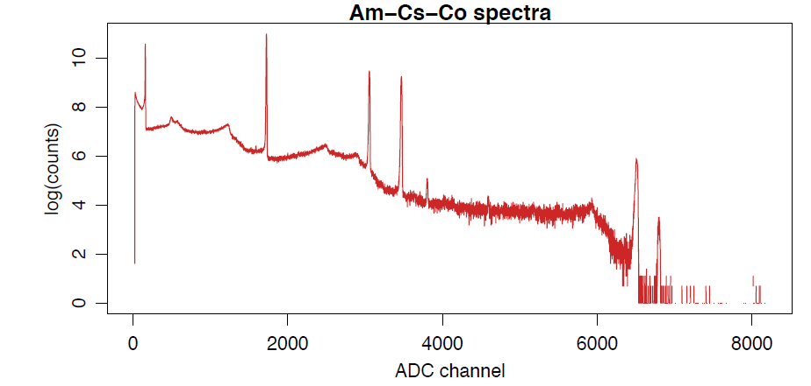
Our goal
Determine the number of events under the source $γ$ source taking into account the underlaying background
Data
We begin by analysing peak by peak.
The first 4 peaks are to be analysed independently.

Slide 4
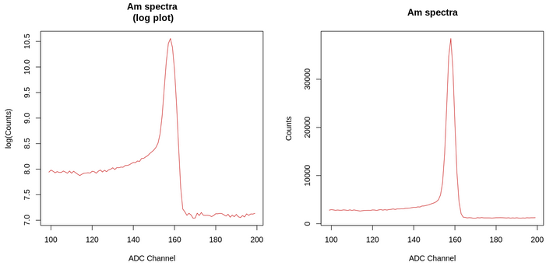
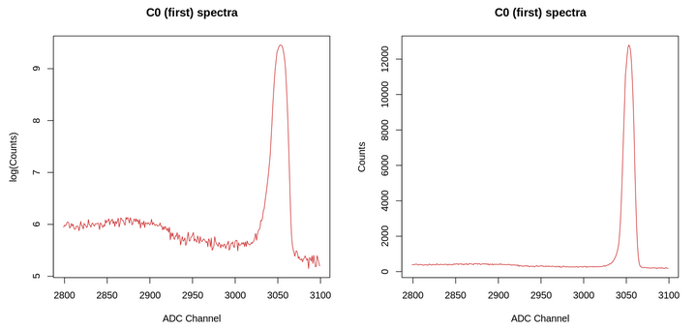
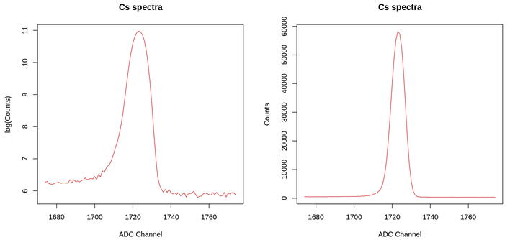
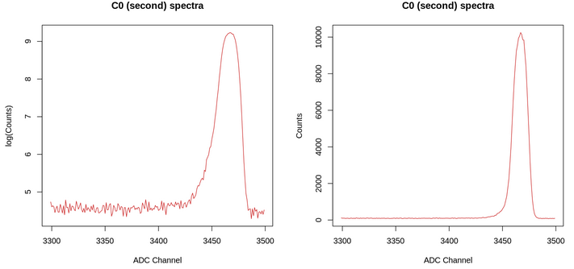

Slide 5
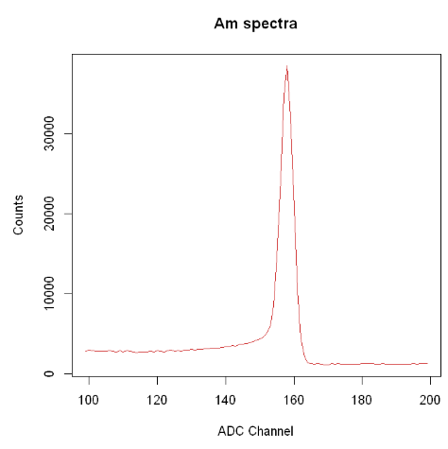
Jags
We assume uniform prior for parameters and arguments are considered by observing the graphs.
The signal was modelled as a Gaussian whereas the number of observed photons follows Poisson distribution.
Bugs model for Am-241
model{
for (i in 1:length(x)){
S[i] <- (A*exp((-(x[i]-x0)^2)/(2*w^2))+B)
y[i] ~ dpois(S[i]) # likelihood of the data}
A ~ dunif(0,60000)
B ~ dunif(0,5000)
w ~ dunif(0,35)
x0 ~ dunif(140,180)
}
Unkowns
A
B
w
x0
Signal Amplitude as counts
Background Amplitude as counts
Width of the signal peak
Center of the signal peak

Slide 6
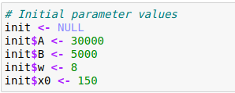
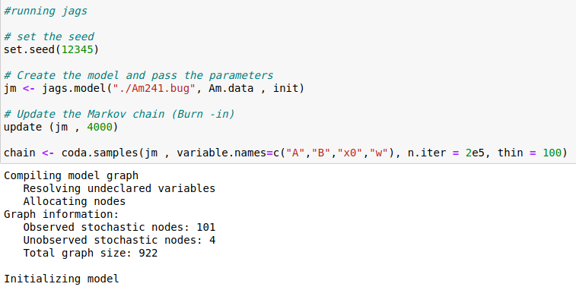
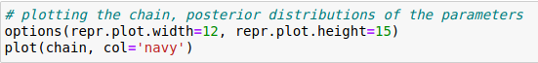
Jags

Slide 7
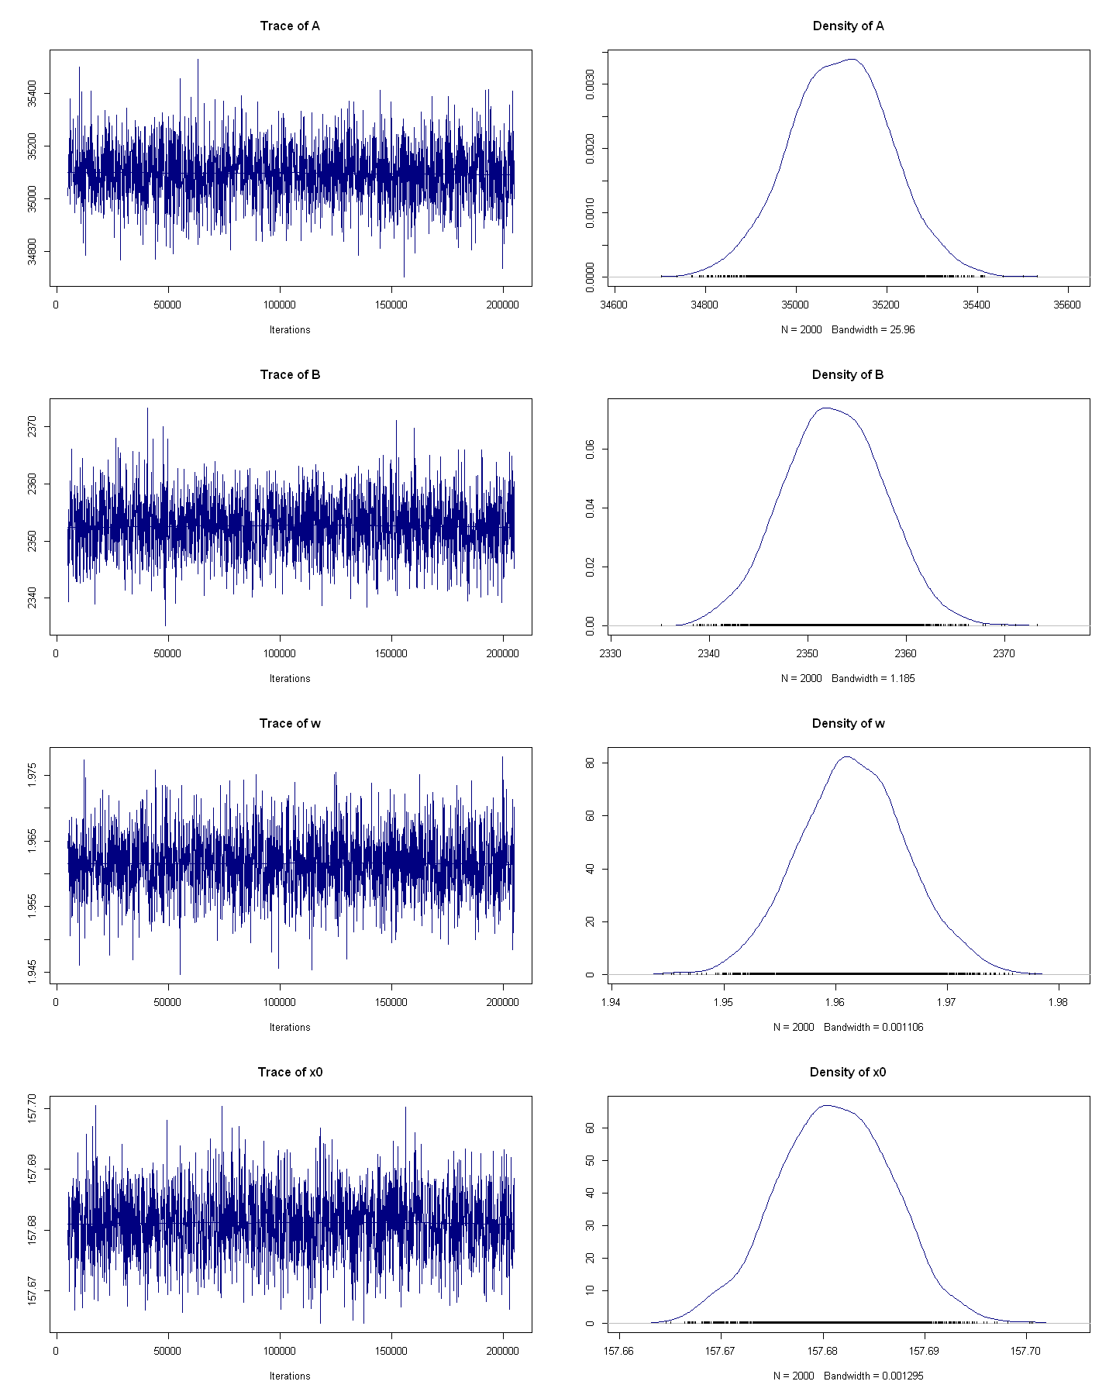
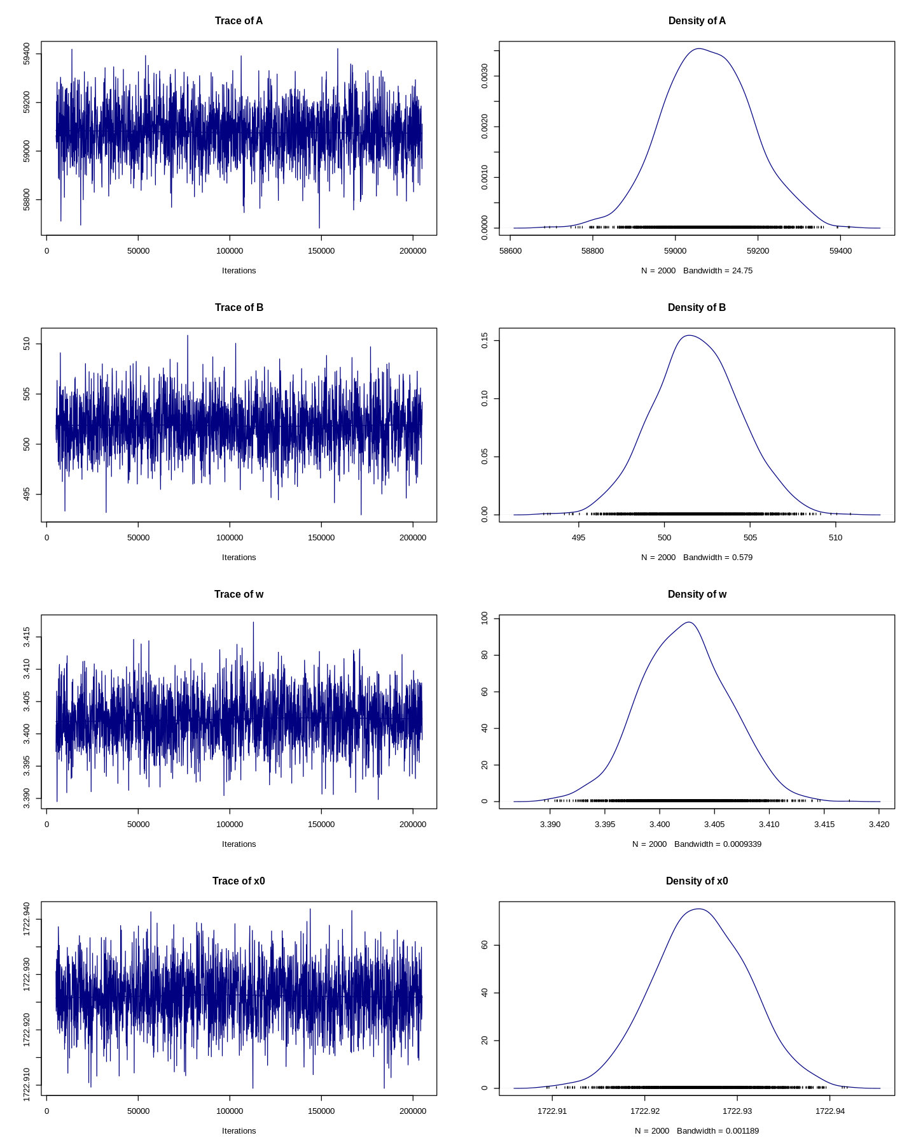
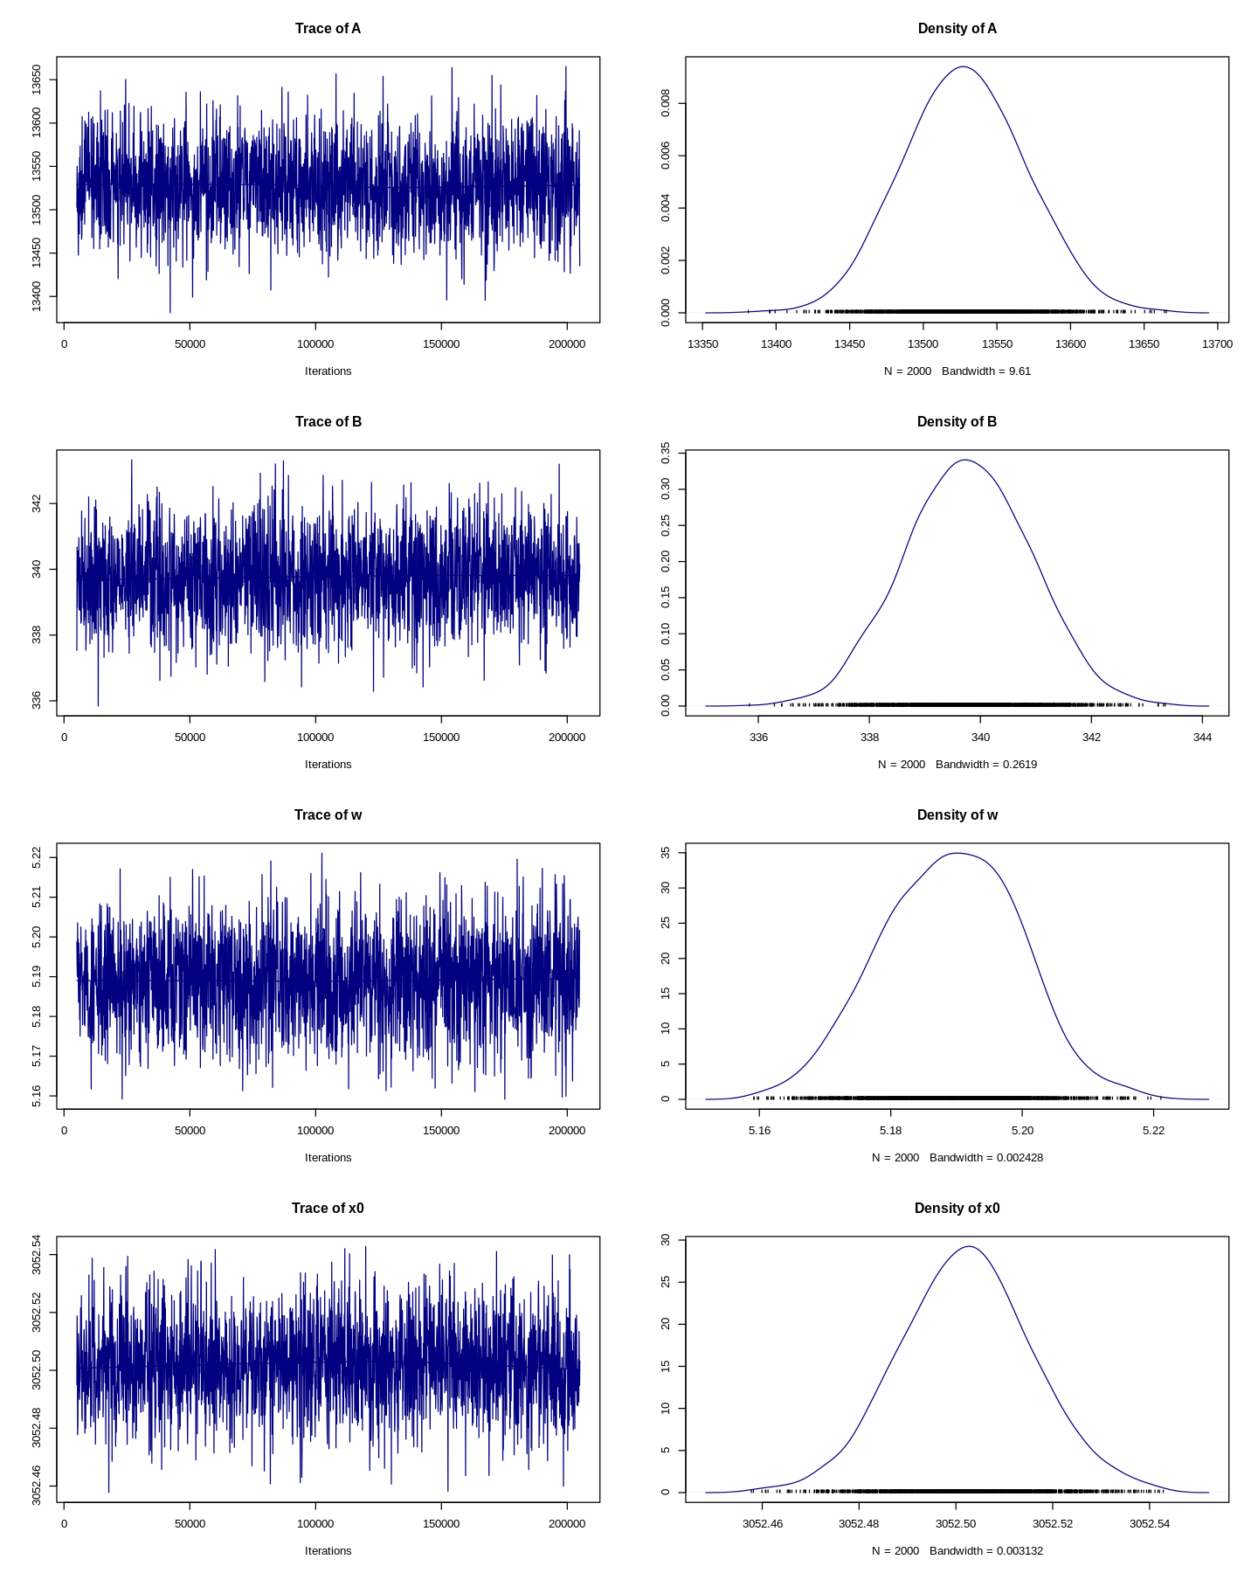
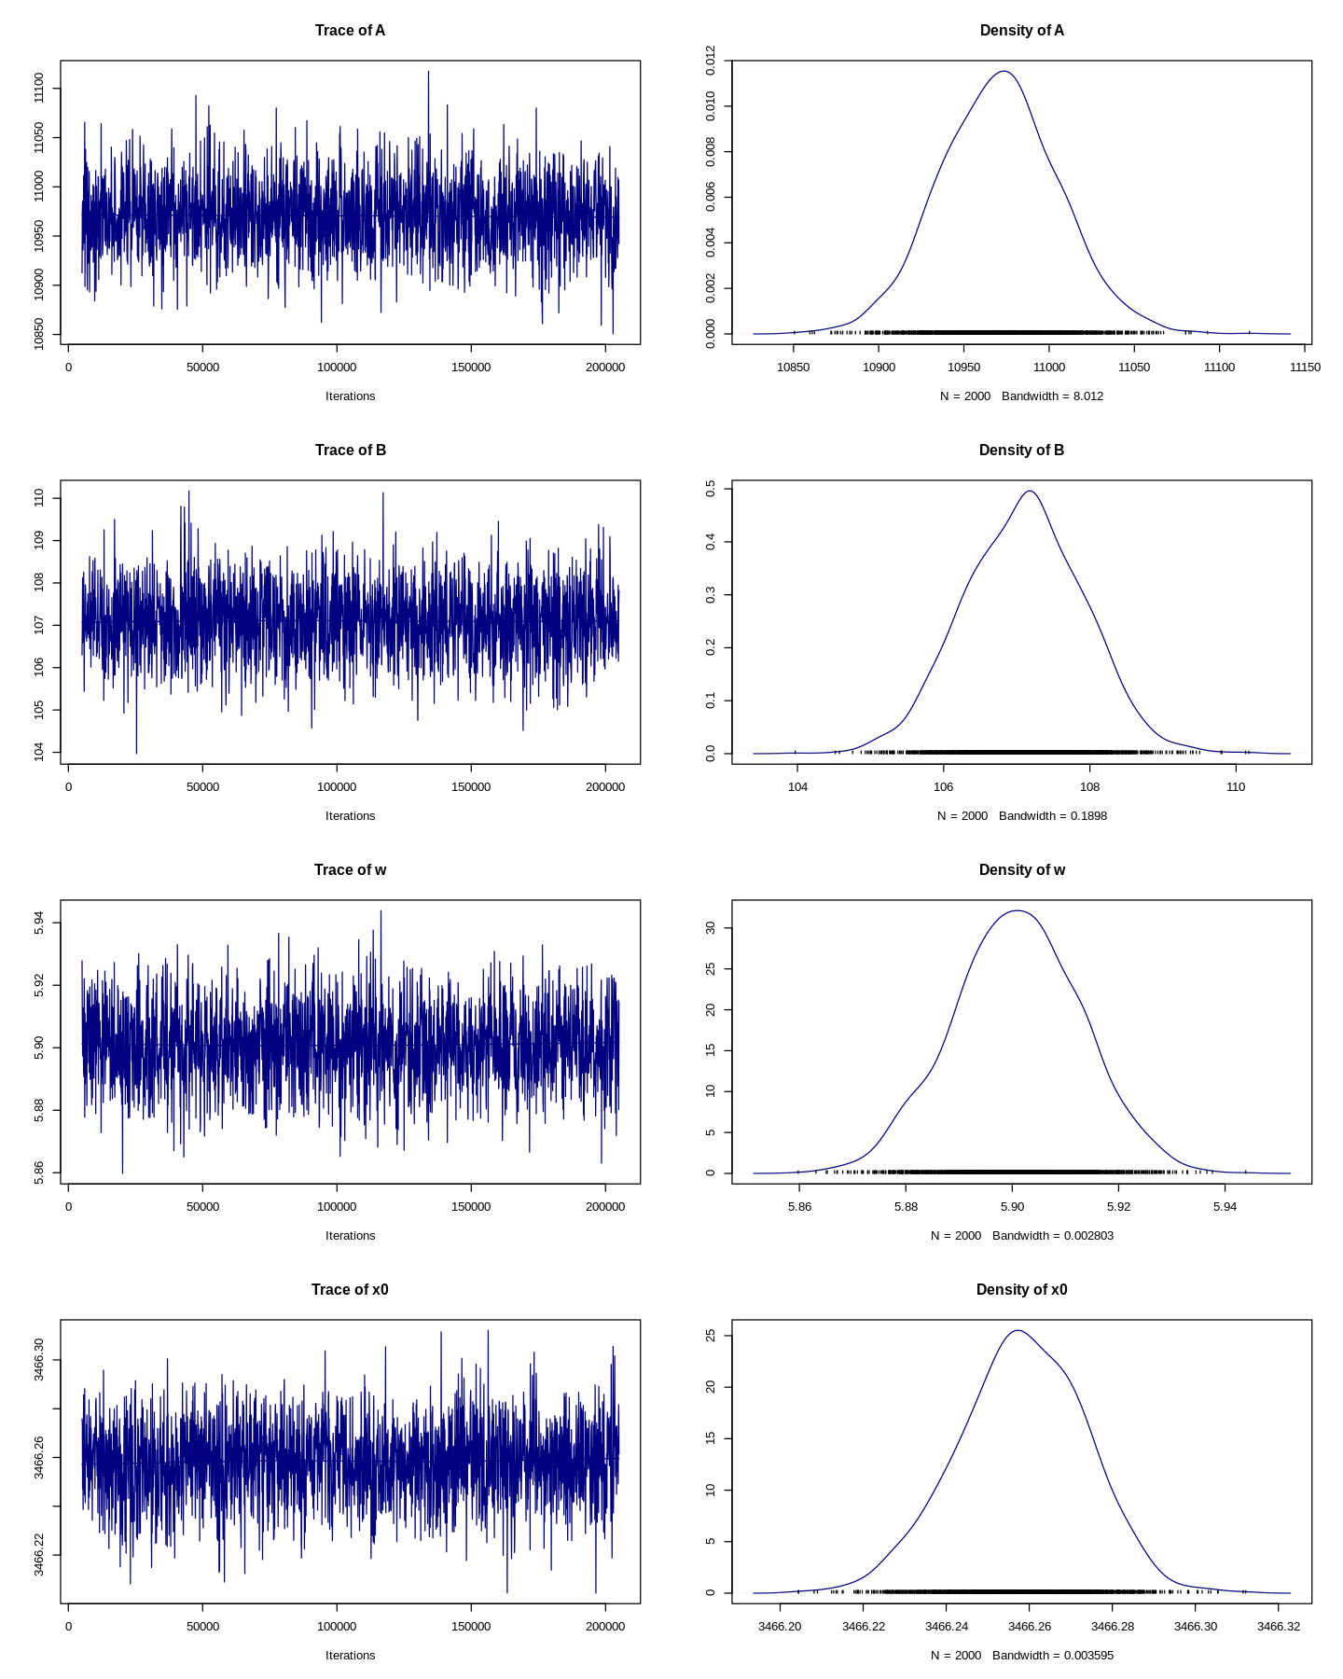
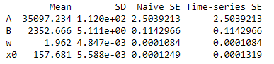
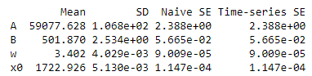
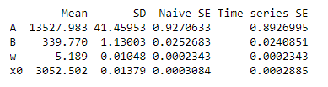
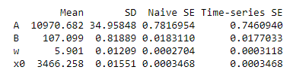
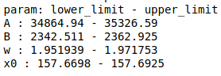
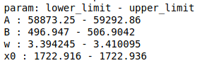
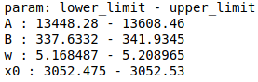
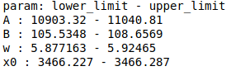
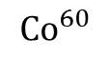
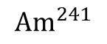
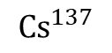
Results from the MCMC
$${Am}^{241}$$
$${Cs}^{137}$$
$${Co}^{60}$$
A
B
W
x0
95%
CI

Slide 8
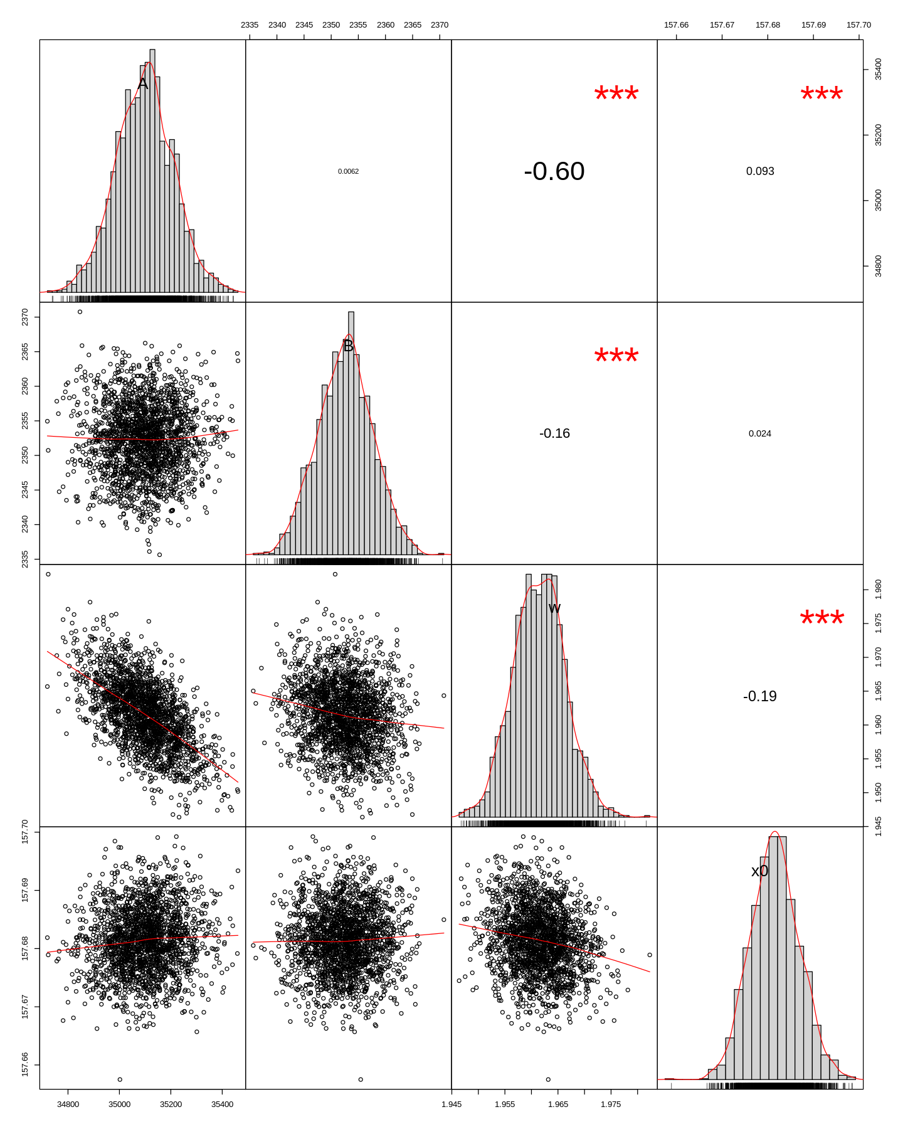
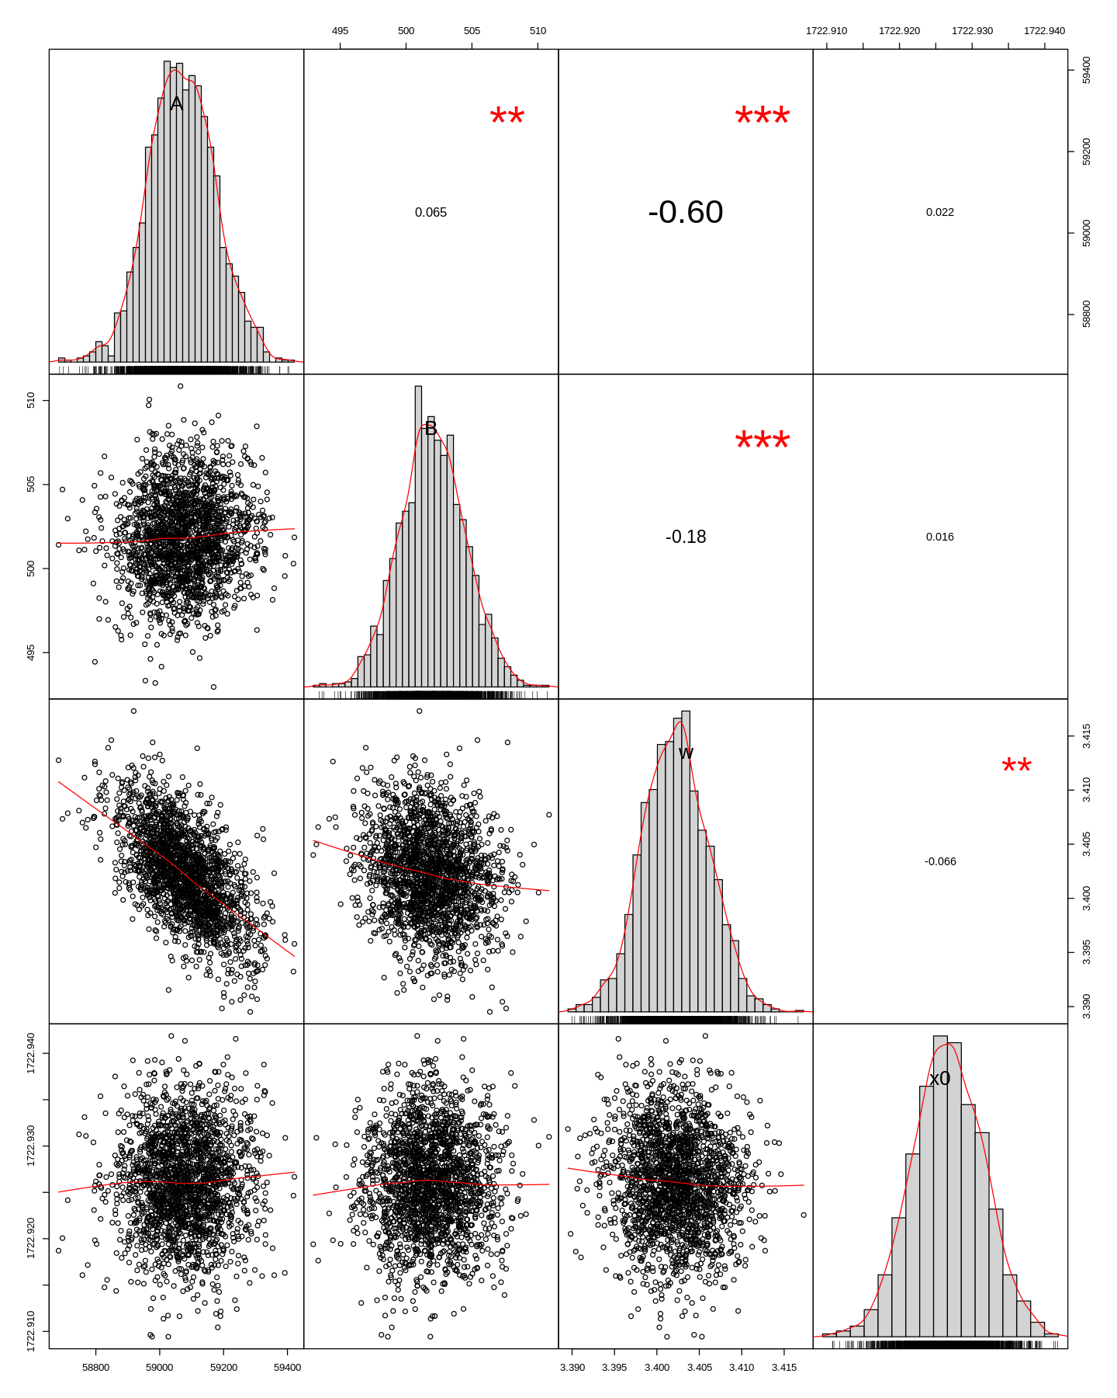
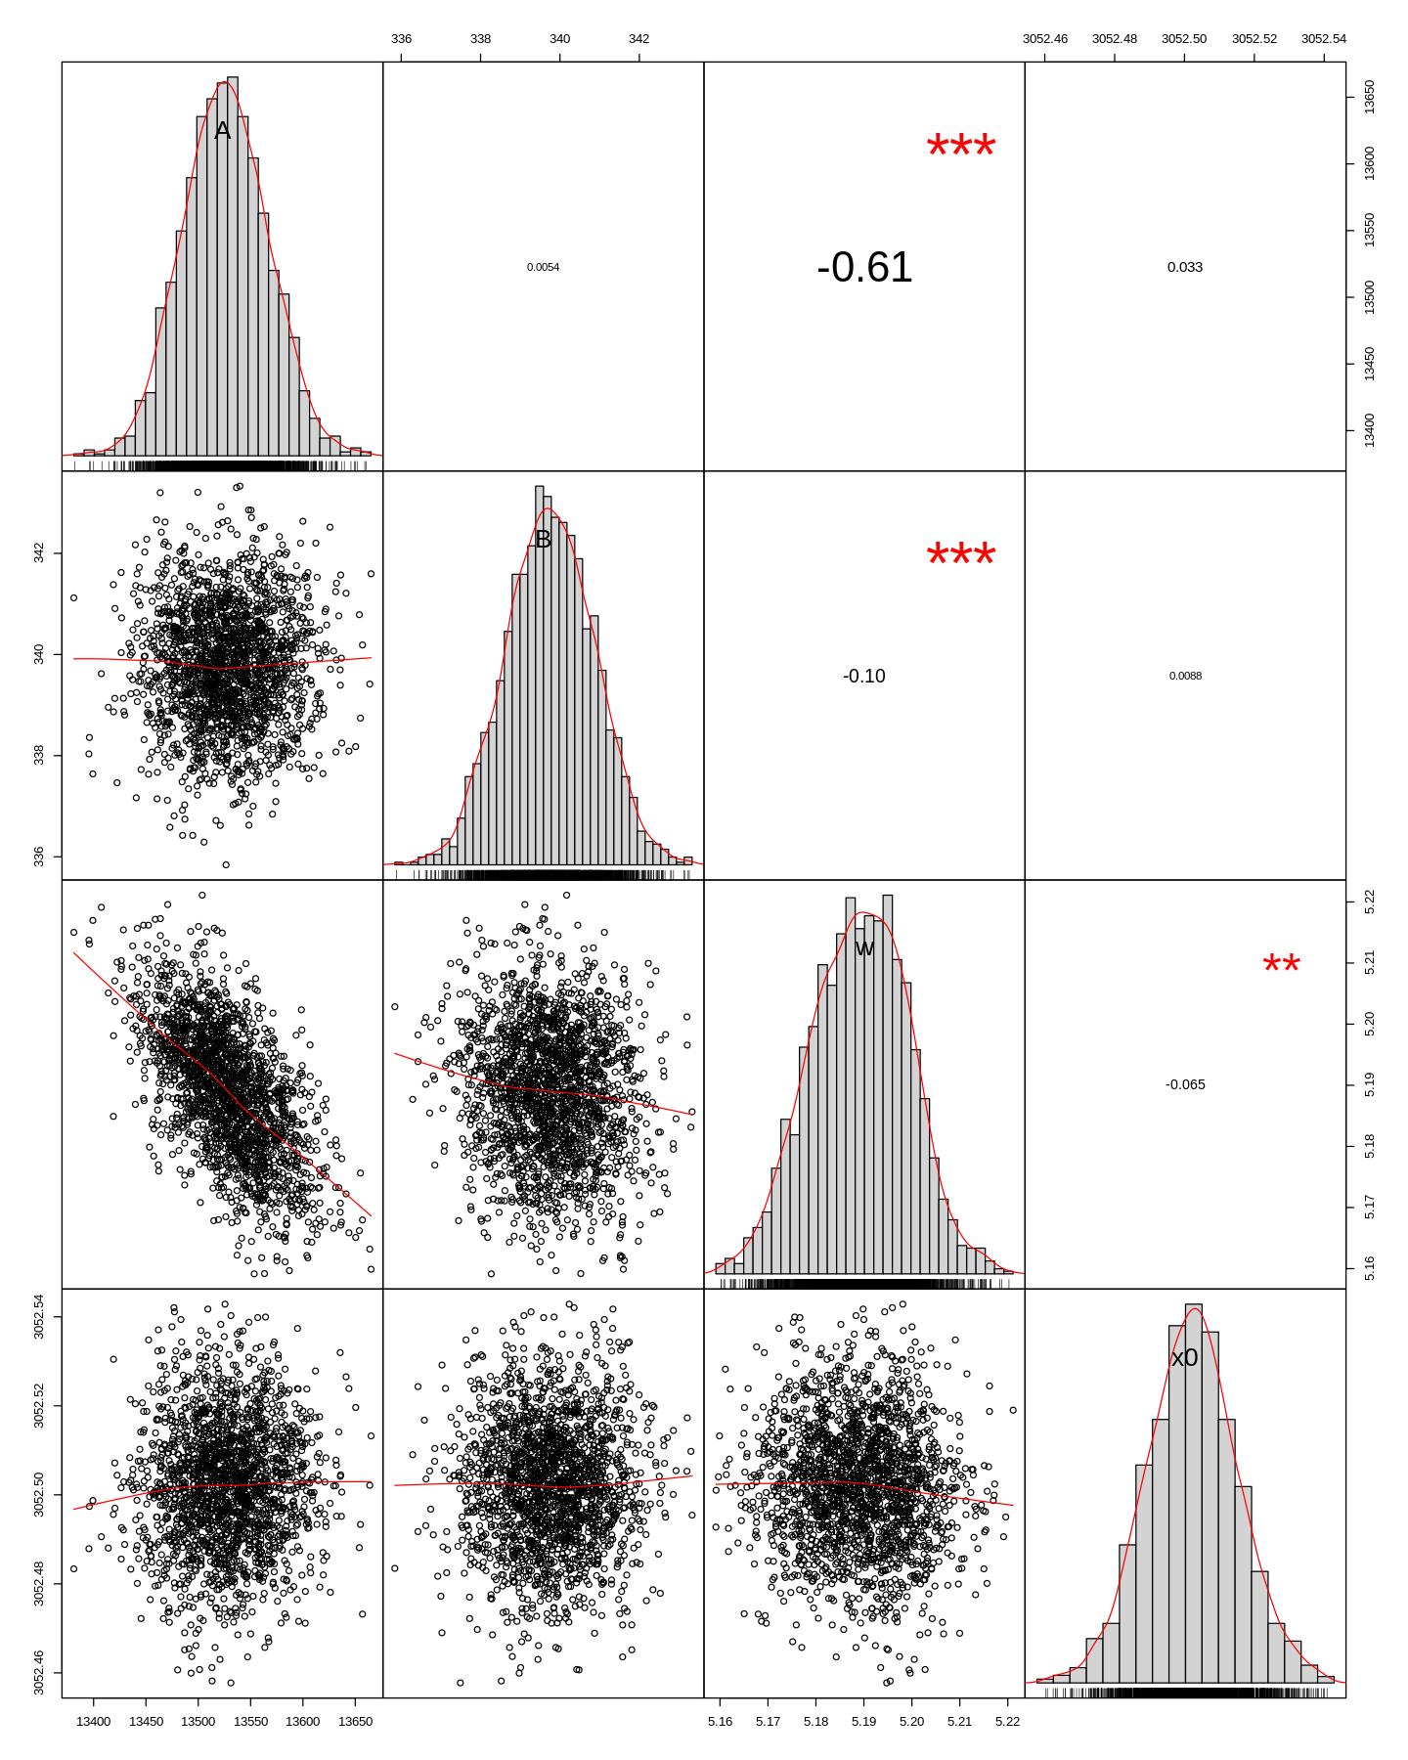
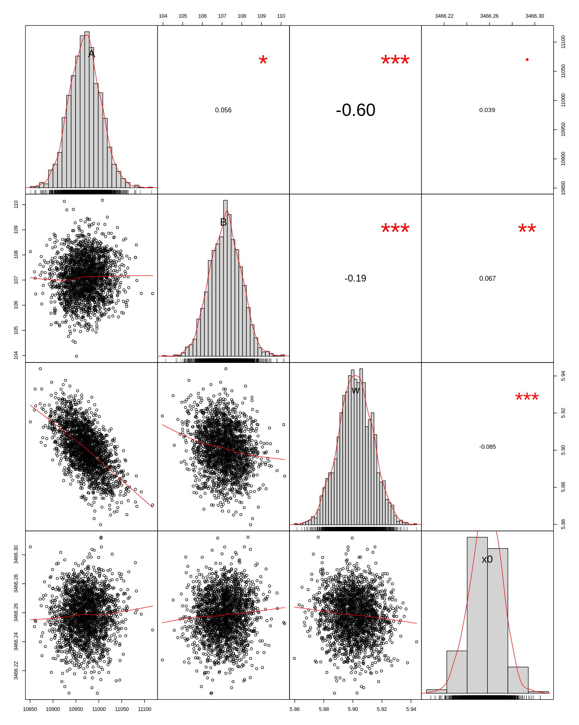
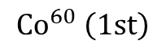
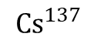
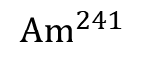
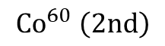
A B W x0
A
B
W
x0
A
B
W
x0
$${Am}^{241}$$
$${Cs}^{137}$$
Correlation among
parameters
A
B
W
x0
Quantitatively, correlation matrix was found using
cor(chain.df)
Signal Amplitude A and width of signal peak w are negatively correlated.
A
B
W
x0
$${Co}^{60} \left(1st\right)$$
$${Co}^{60} \left(2nd\right)$$

Slide 9
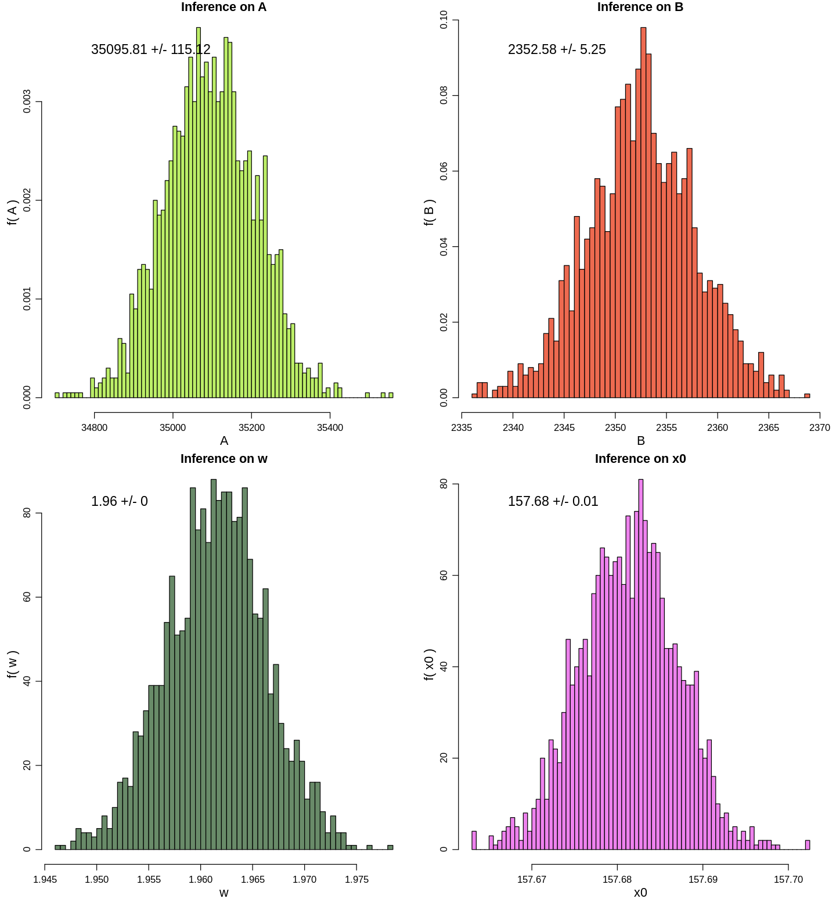
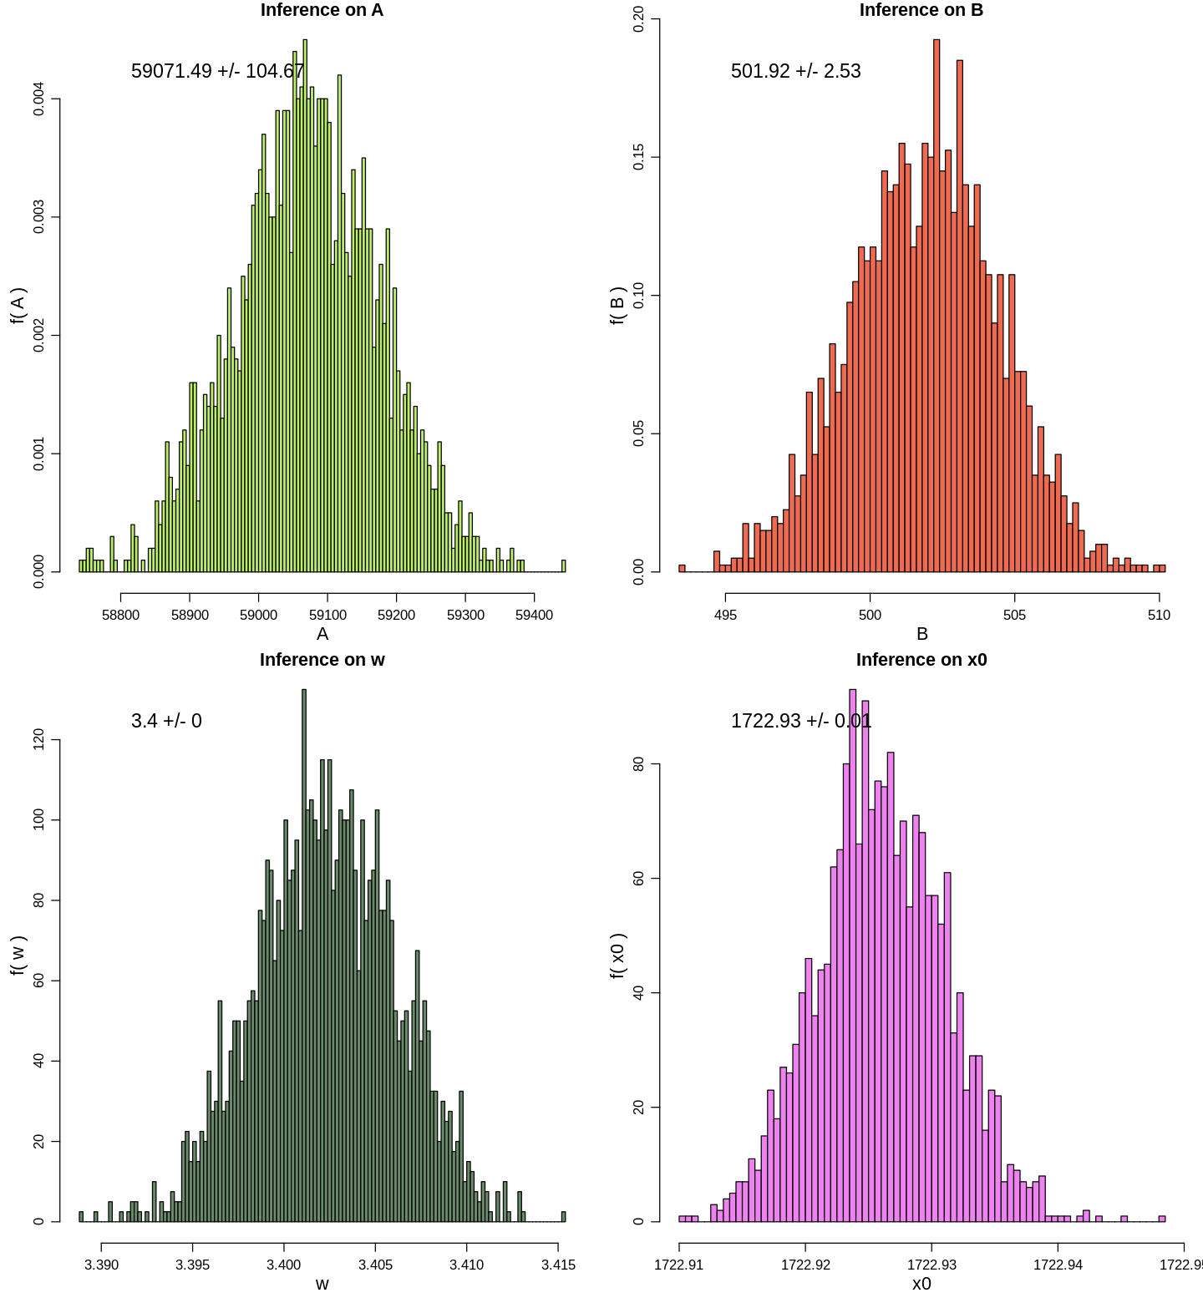
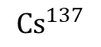
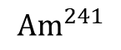
$${Am}^{241}$$
Histograms
$${Cs}^{137}$$

Slide 10
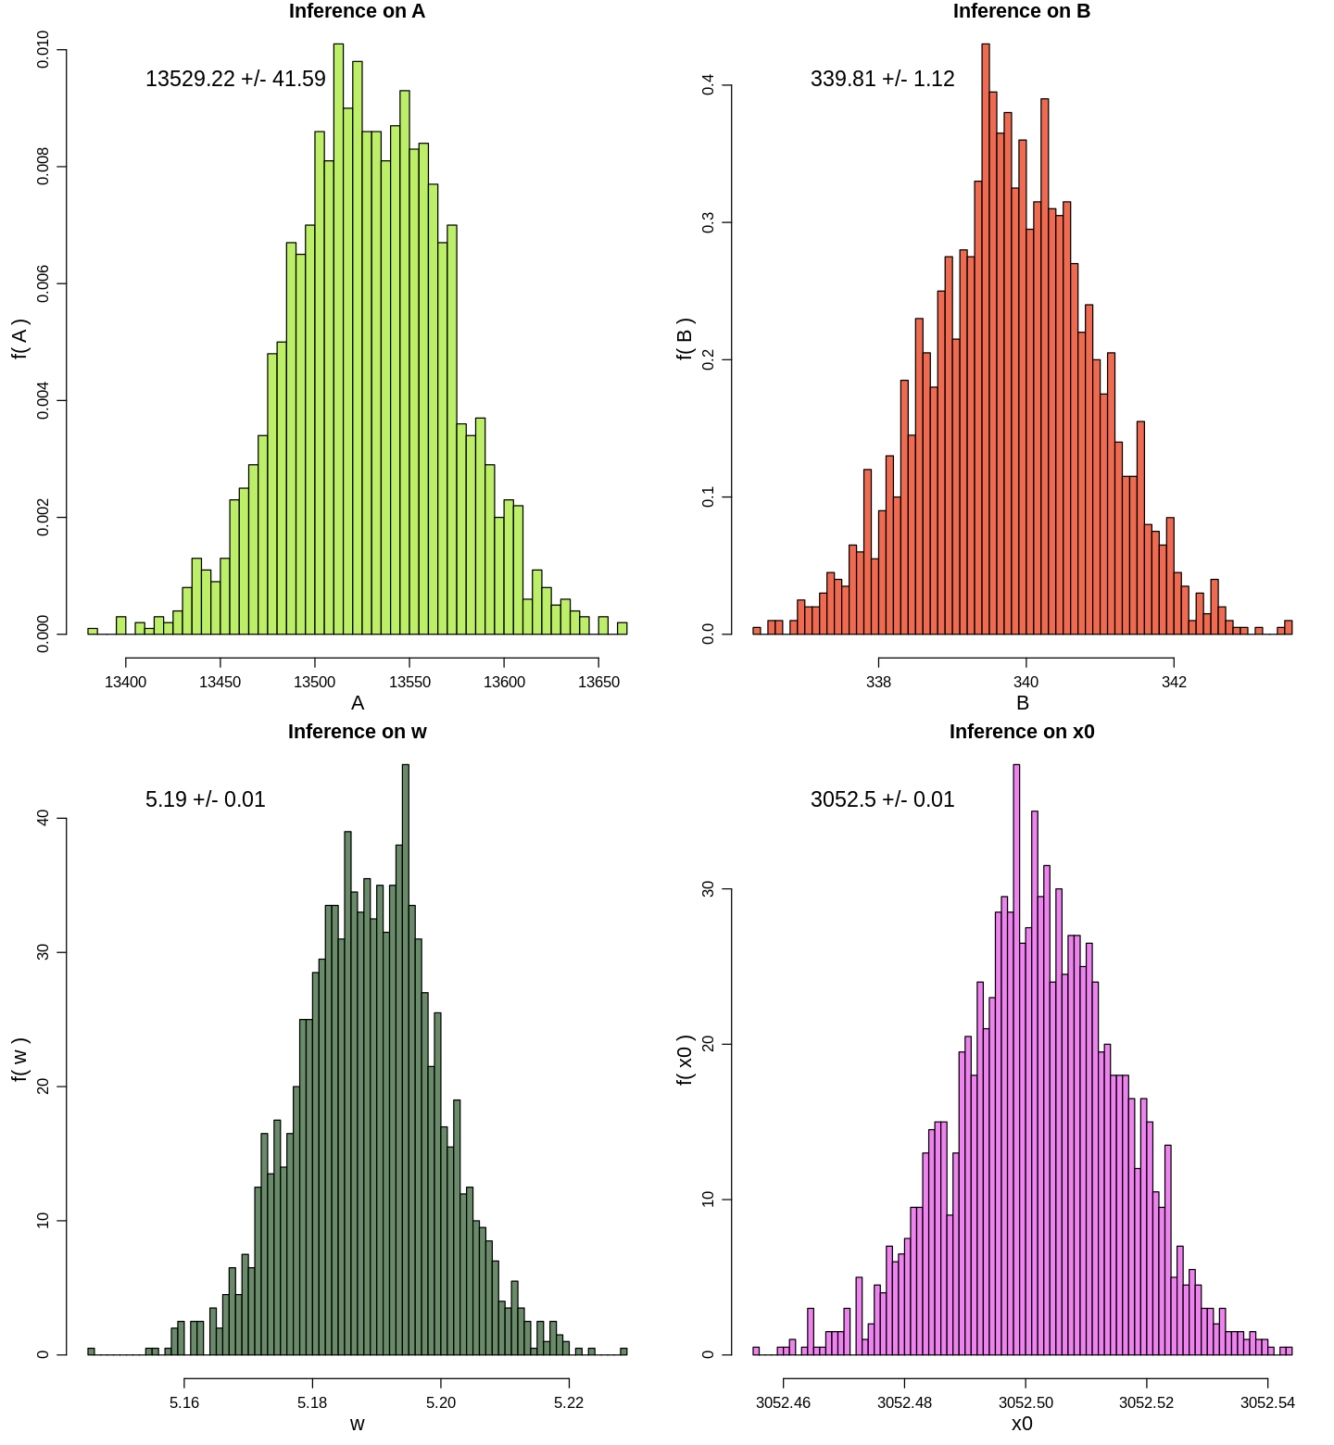
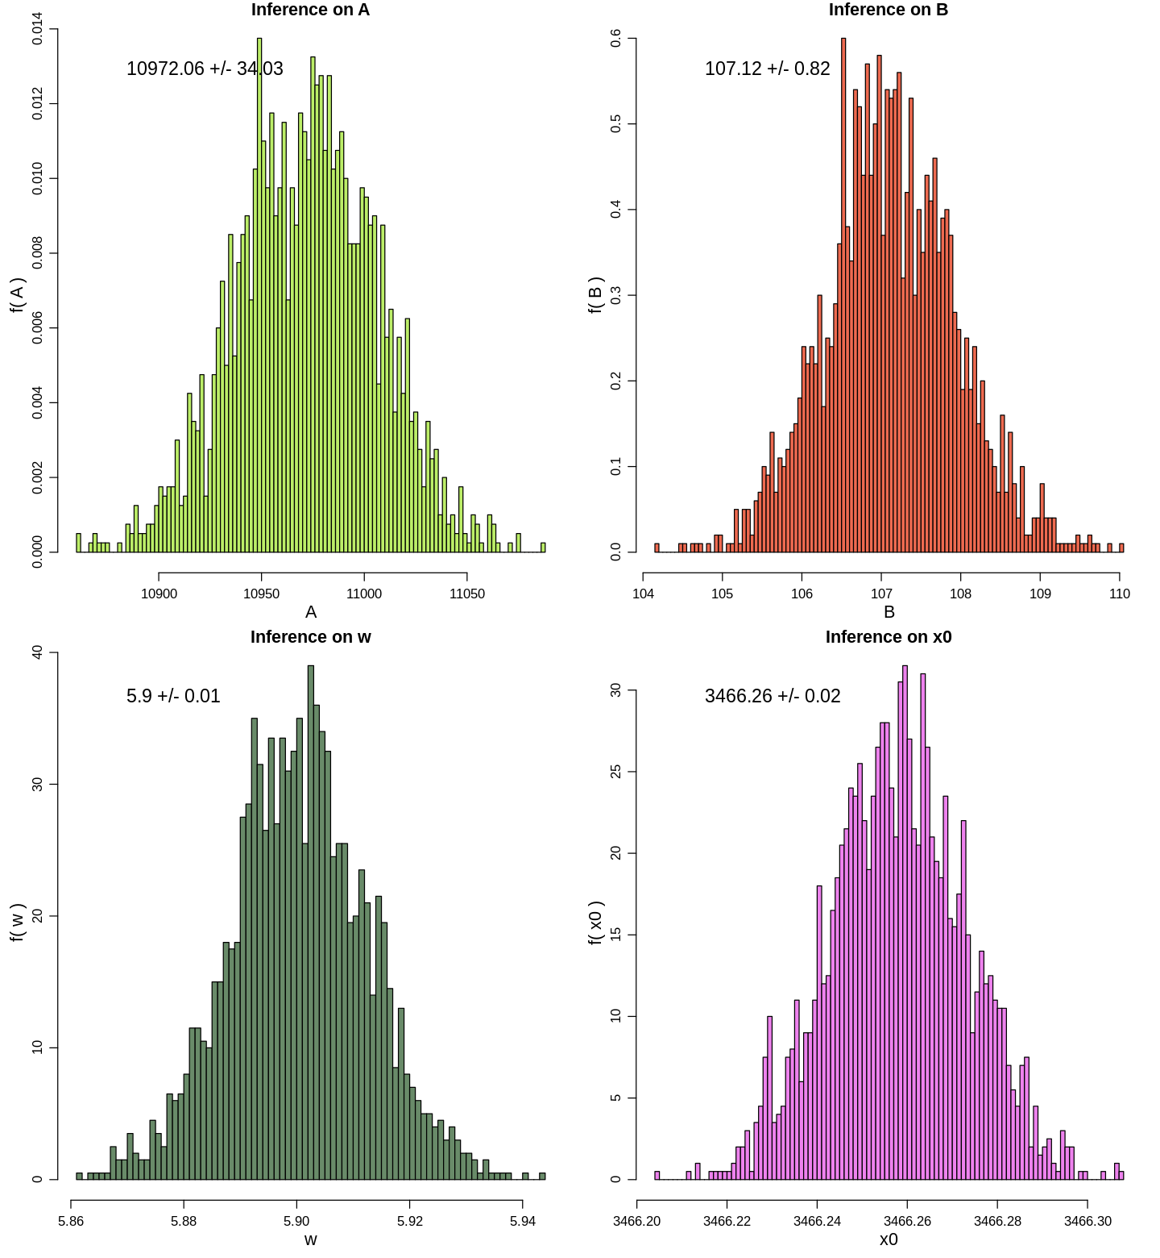
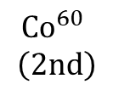
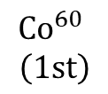
$${Co}^{60}$$
$$\left(1st\right)$$
Histograms
$${Co}^{60}$$
$$\left(2nd\right)$$

Slide 11
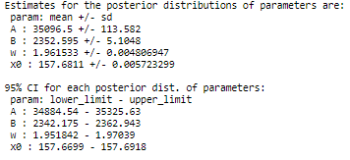
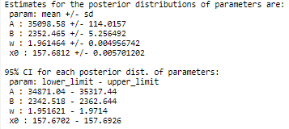
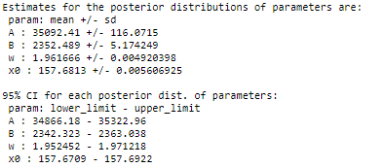
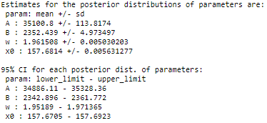
Convergence of MCMC
Check whether the chain has reached a steady state by rerunning the sampling several times with different starting points
All chains should converge to the same region of parameter space
Initial values | First experiment | Second experiment | Third experiment | Fourth experiment
A | 30000 | 50000 | 25000 | 20000
B | 5000 | 3500 | 2000 | 4000
W | 8 | 20 | 15 | 5
X0 | 150 | 180 | 140 | 170
Estimates for the posterior distribution
Estimates for the posterior distribution 95% CI

Slide 12
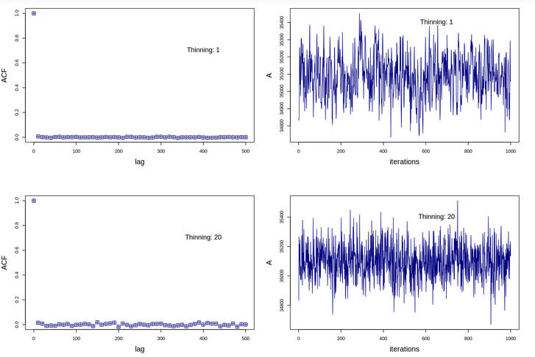
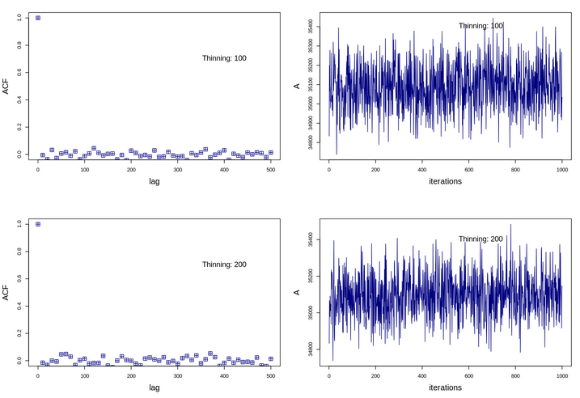
Convergence of MCMC
Effect of thinning on Auto-correlation
Auto-correlation or ACF(h) measures how closely the chain is correlated with itself h steps later
Burn in =
2000
Even with small values of burn-in and thin = 10, for a given parameter (for eg, A), there is not much correlation h steps later for any h>1.

Slide 13
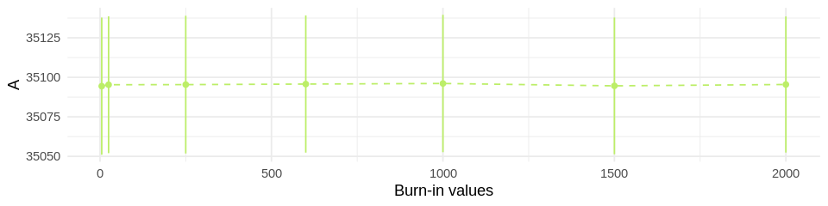
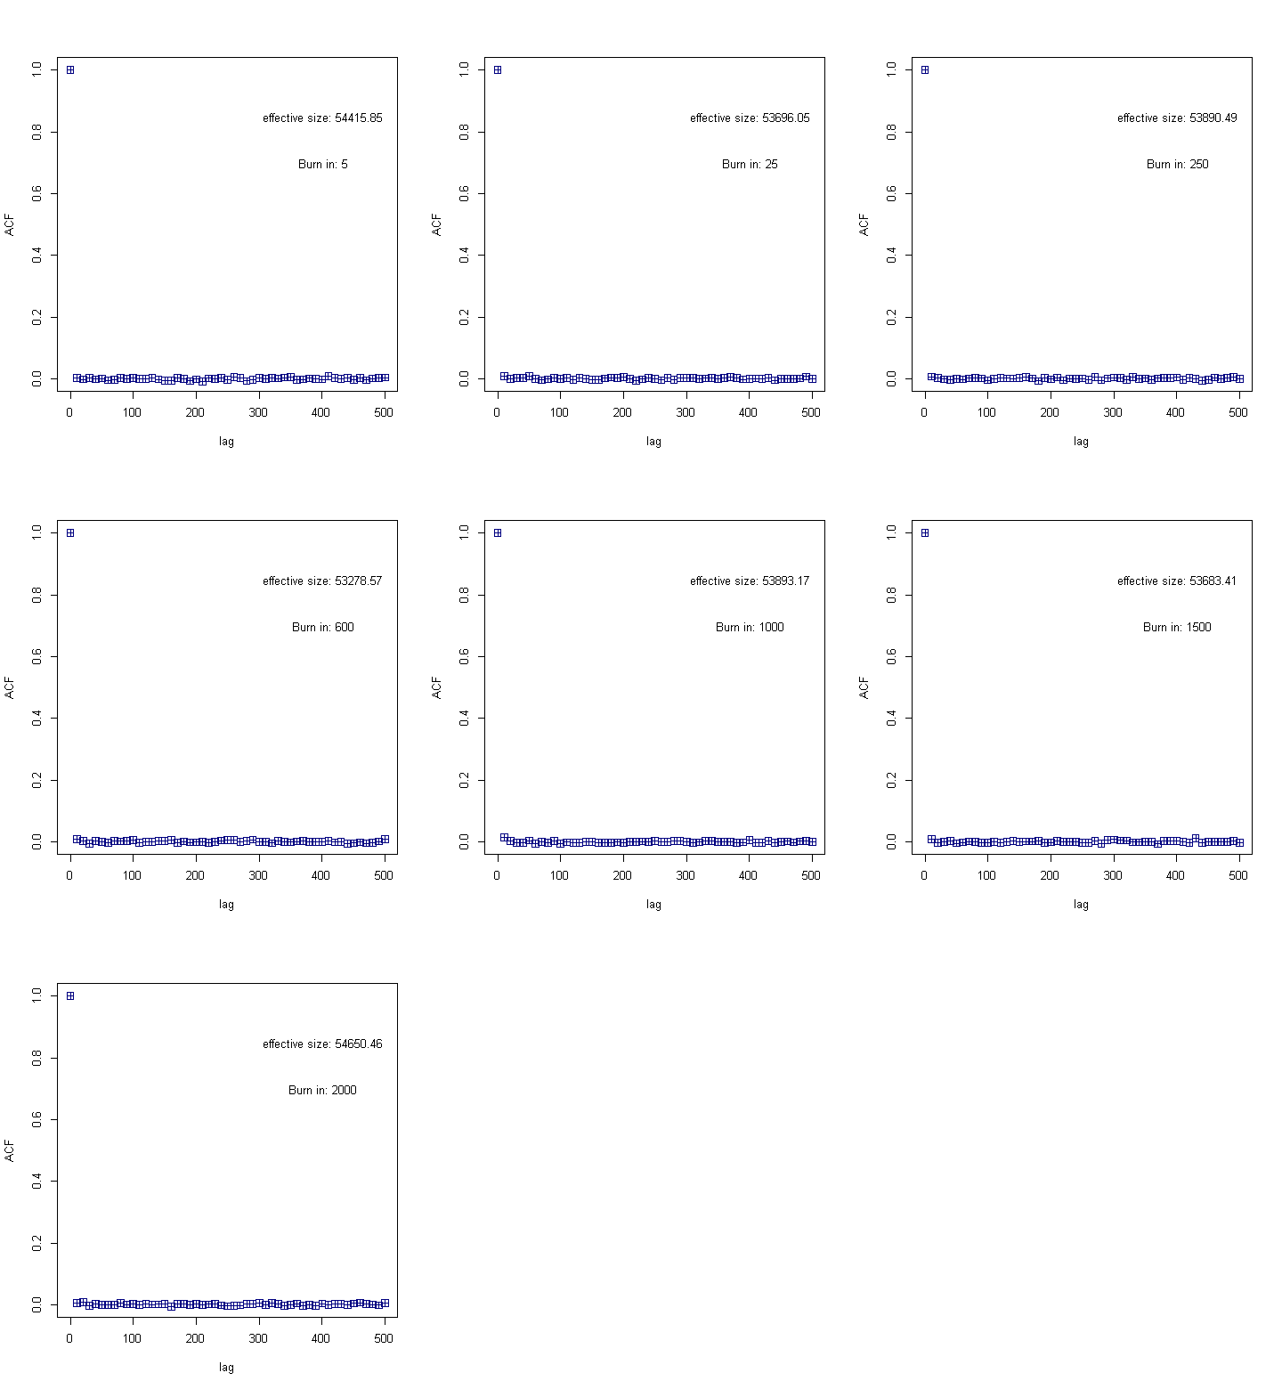
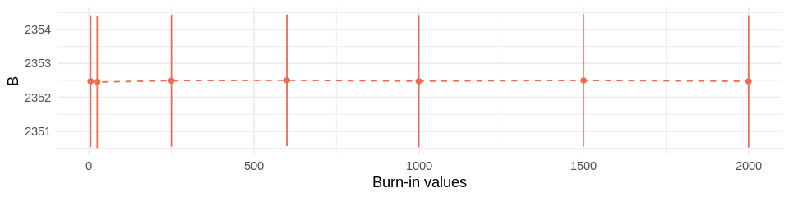


Thin =
1
Convergence of MCMC
Effect of burn-in on
Auto-correlation

Slide 14




Calibration
Energy = ADC channel slope + intercept
Intercept = -1.1627
Slope = 0.3847

Slide 15


Estimating number of events
Delete first comment

Slide 16










Estimating number of events Results
Number of events under the peak of
${Am}^{241}$ :
172585.2
Number of events under the peak of
${ Cs}^{137}\left(1st\right)$:
503785
Number of events under the peak of
$${ Co}^{60} \left(1st\right):$$
175961.2
Number of events under the peak of
${ Co}^{60} \left(2nd\right)$:
162277.2

Slide 17
Thank you for your attention

